Slide 1
Layout Managers

Slide 2
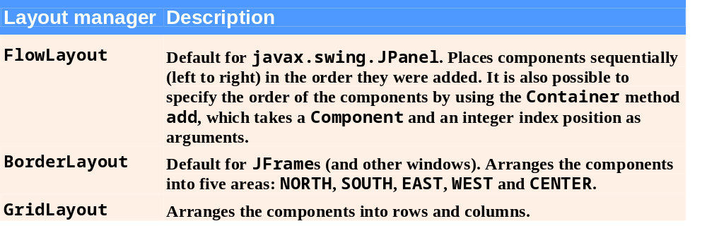


Layout Managers
Layout managers
  Provided to arrange GUI components in a container
  Provide basic layout capabilities
  Implement the interface LayoutManager

Slide 3
Look-and-Feel Observation 11.17
It is possible to set a Container’s layout to null, which indicates that no layout manager should be used. In a Container without a layout manager, the programmer must position and size the components in the given container and take care that, on resize events, all components are repositioned as necessary. A component’s resize events can be processed by a ComponentListener.

Slide 4
Null layout manager example
pane.setLayout(null);
JButton b1 = new JButton("one"); JButton b2 = new JButton("two");
JButton b3 = new JButton("three");
pane.add(b1); pane.add(b2); pane.add(b3);
Insets insets = pane.getInsets();
Dimension size = b1.getPreferredSize();
b1.setBounds(25 + insets.left, 5 + insets.top, size.width, size.height);
size = b2.getPreferredSize();
b2.setBounds(55 + insets.left, 40 + insets.top, size.width, size.height);
size = b3.getPreferredSize();
b3.setBounds(150 + insets.left, 15 + insets.top, size.width + 50, size.height + 20);
...//In the main method:
Insets insets = frame.getInsets();
frame.setSize(300 + insets.left + insets.right, 125 + insets.top + insets.bottom);

Slide 5
FlowLayout
FlowLayout
  Simplest layout manager
  Components are placed left to right in the order they are added
  Components can be left aligned, centered or right aligned

Slide 6

FlowLayout Demo

Slide 7
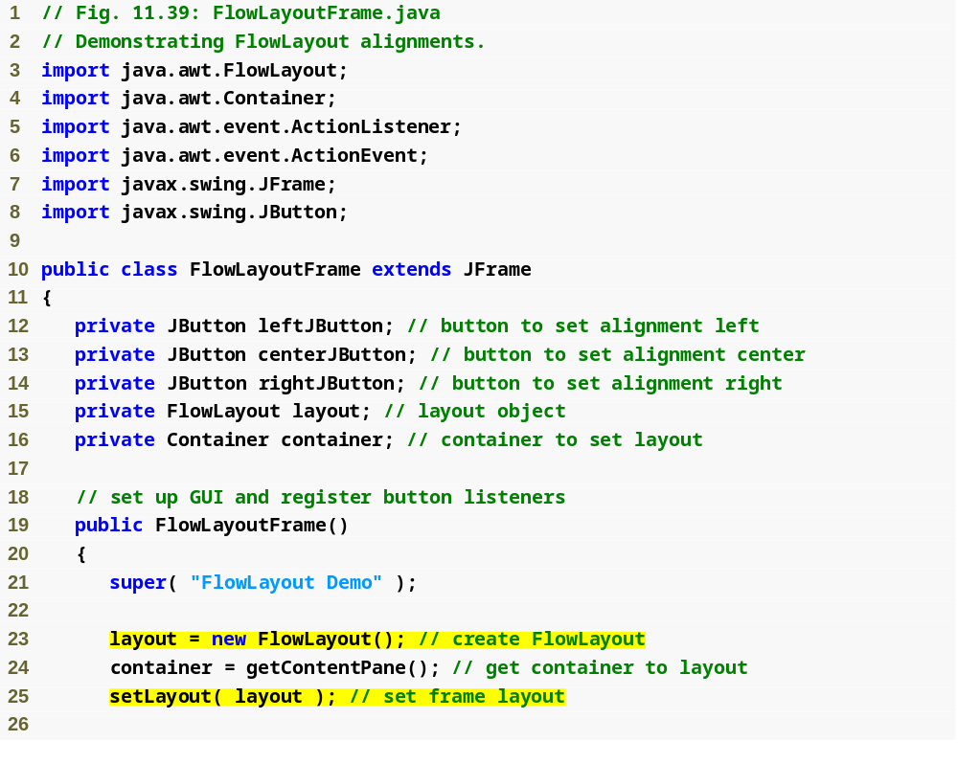
Outline
FlowLayoutFrame
.java
(1 of 3)
Create FlowLayout
Set layout of application

Slide 8
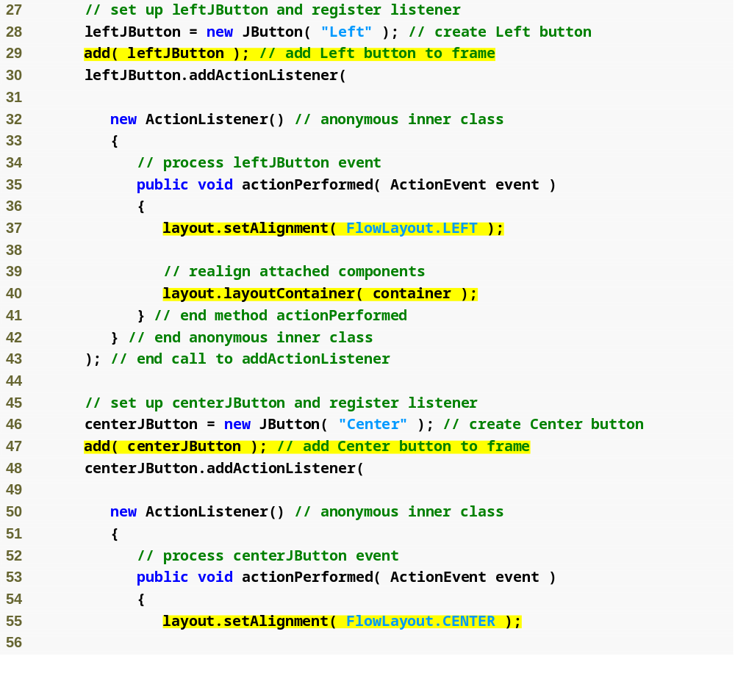
Outline
Add JButton; FlowLayout will handle placement
FlowLayoutFrame
.java
(2 of 3)
Set alignment to left
Adjust layout
Add JButton; FlowLayout will handle placement
Set alignment to center

Slide 9
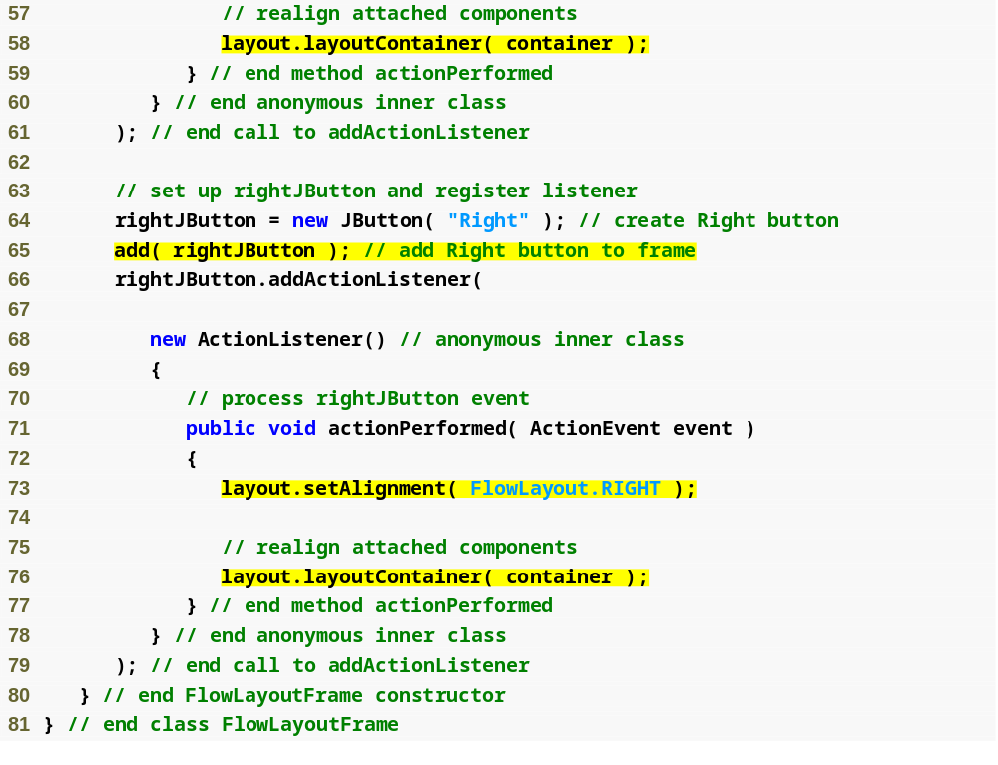
Outline
Adjust layout
FlowLayoutFrame
.java
(3 of 3)
Add JButton; FlowLayout will handle placement
Set alignment to right
Adjust layout

Slide 10
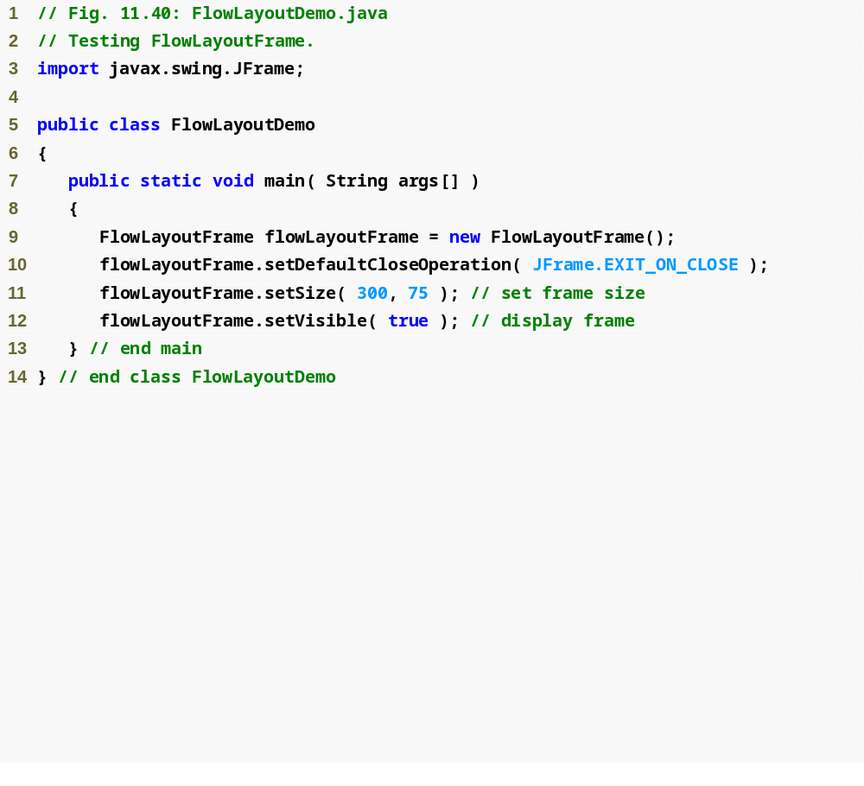

Outline
FlowLayoutDemo
.java
(1 of 2)

Slide 11



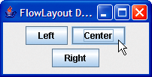
Outline
FlowLayoutDemo
.java
(2 of 2)

Slide 12
BorderLayout
BorderLayout
  Arranges components into five regions – north, south, east, west and center
  Implements interface LayoutManager2
  Provides horizontal gap spacing and vertical gap spacing

Slide 13
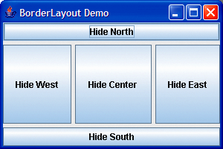

BorderLayout Demo

Slide 14
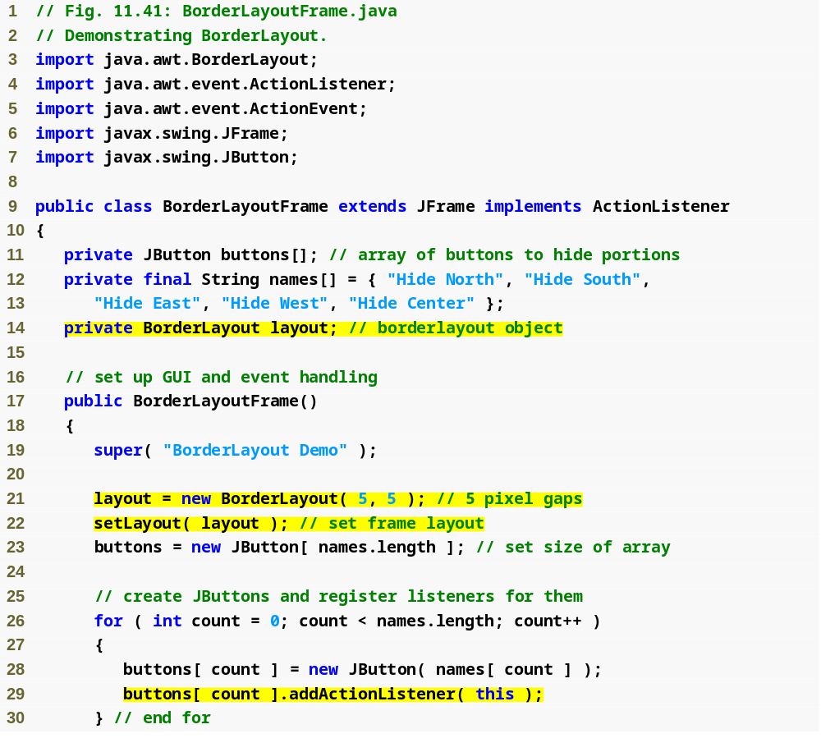
Outline
BorderLayout
Frame.java
(1 of 2)
Declare BorderLayout instance variable
Create BorderLayout
Set layout
Register event handler

Slide 15
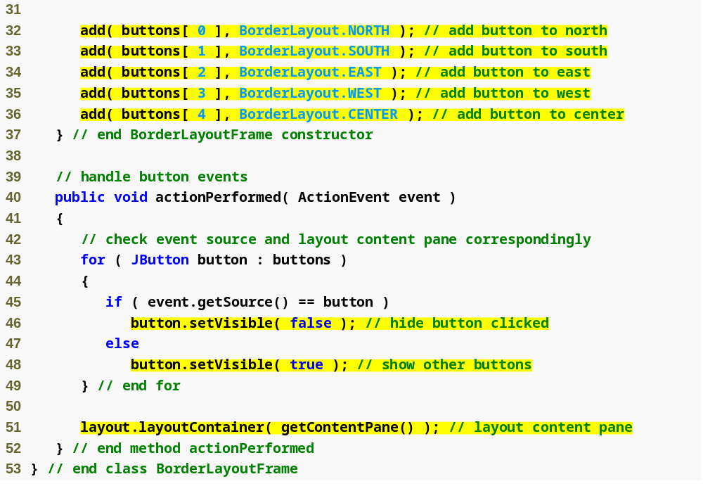
Outline
BorderLayout
Frame.java
(2 of 2)
Add buttons to application using layout manager constants
Make button invisible
Make button visible
Update layout

Slide 16
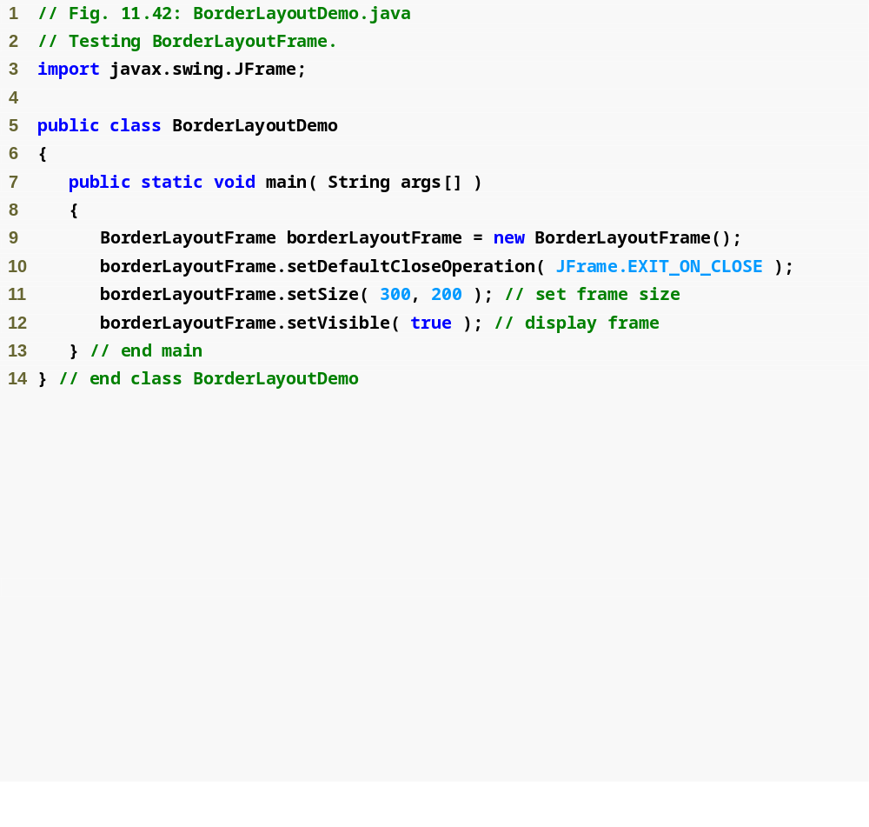
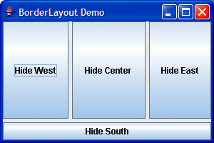
Outline
BorderLayout
Demo.java
(1 of 2)
horizontal gap
vertical gap

Slide 17

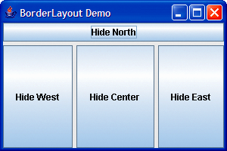
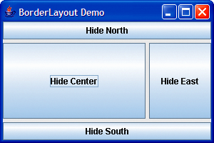
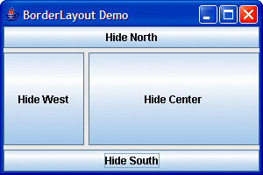
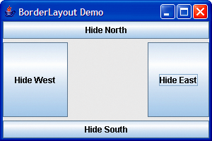
Outline
BorderLayout
Demo.java
(2 of 2)

Slide 18
11.17.3 GridLayout
GridLayout
  Divides container into a grid
  Every component has the same width and height

Slide 19
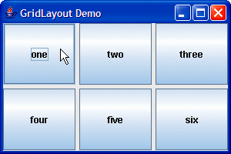
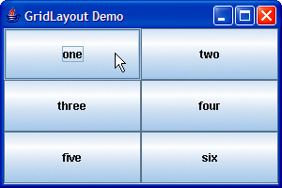
GridLayout Demo

Slide 20
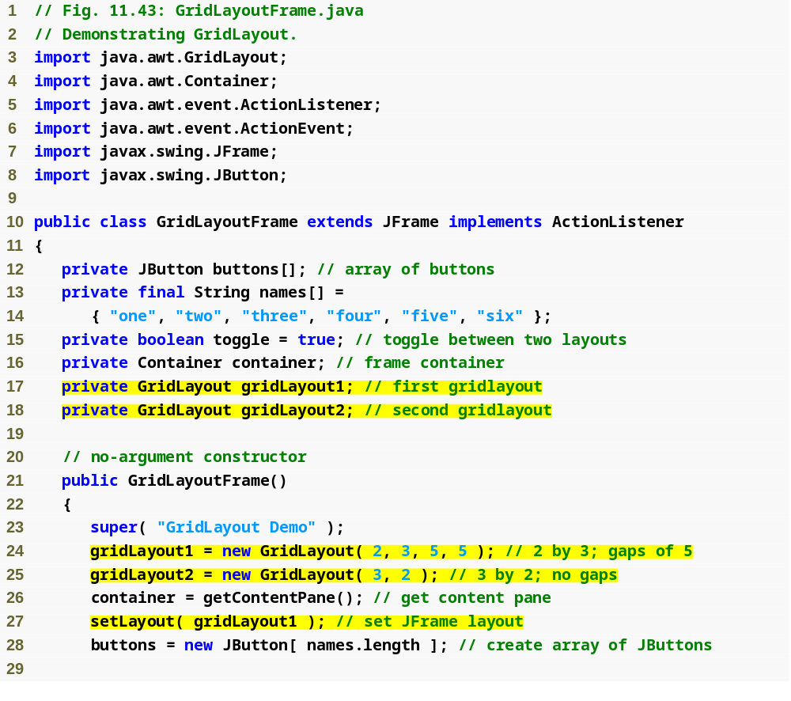
Outline
GridLayout
Frame.java
(1 of 2)
Declare two GridLayout instance variables
Create GridLayout
Set layout

Slide 21
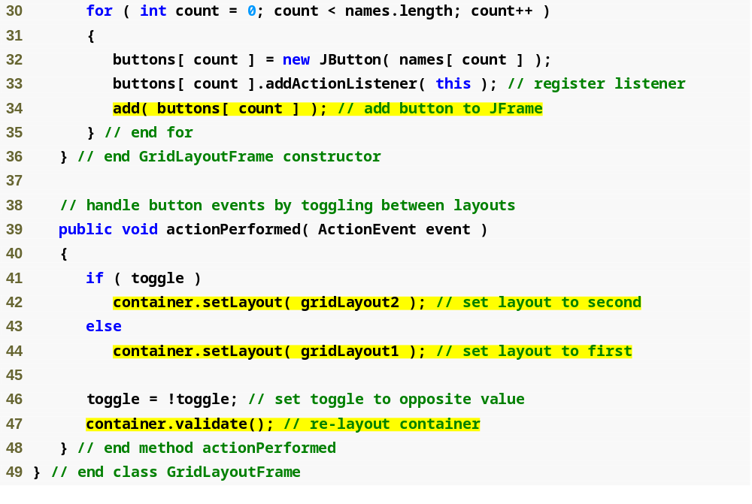
Outline
Add button to JFrame
GridLayout
Frame.java
(2 of 2)
Use second layout
Use first layout
Update layout

Slide 22
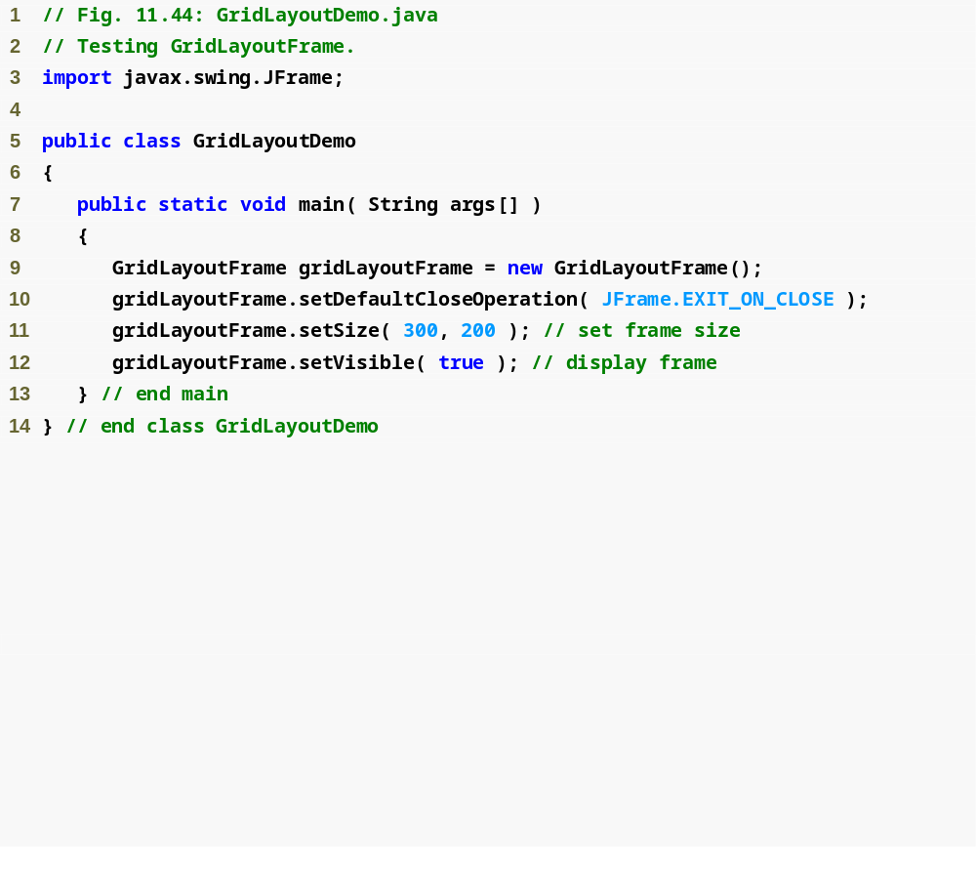
Outline
GridLayoutDemo
.java

Slide 23
Using Panels to Manage More Complex Layouts
Complex GUIs often require multiple panels to arrange their components properly

Slide 24
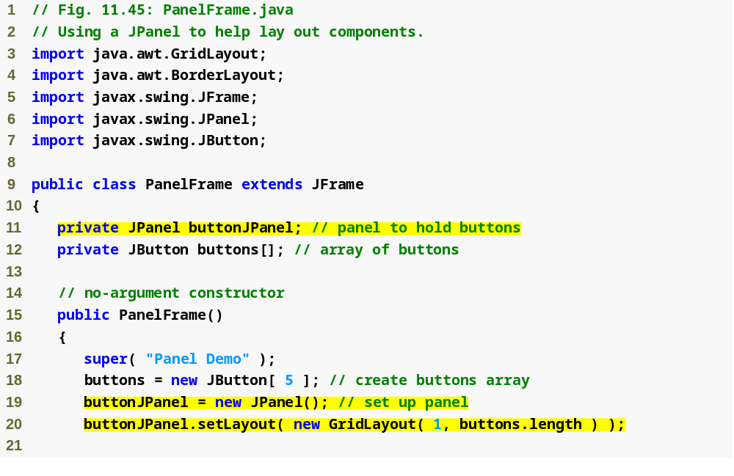
Outline
PanelFrame.java
(1 of 2)
Declare a JPanel to hold buttons
Create JPanel
Set layout

Slide 25
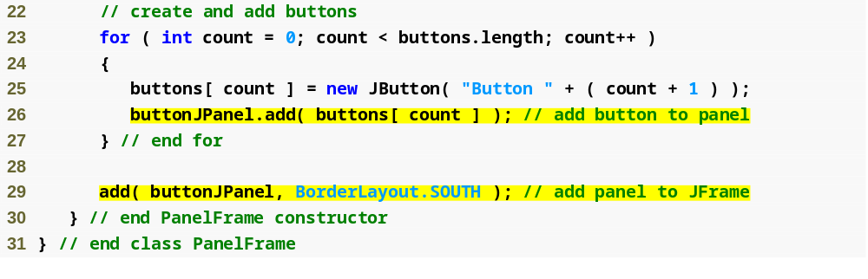
Outline
Add button to panel
PanelFrame.java
(2 of 2)
Add panel to application

Slide 26
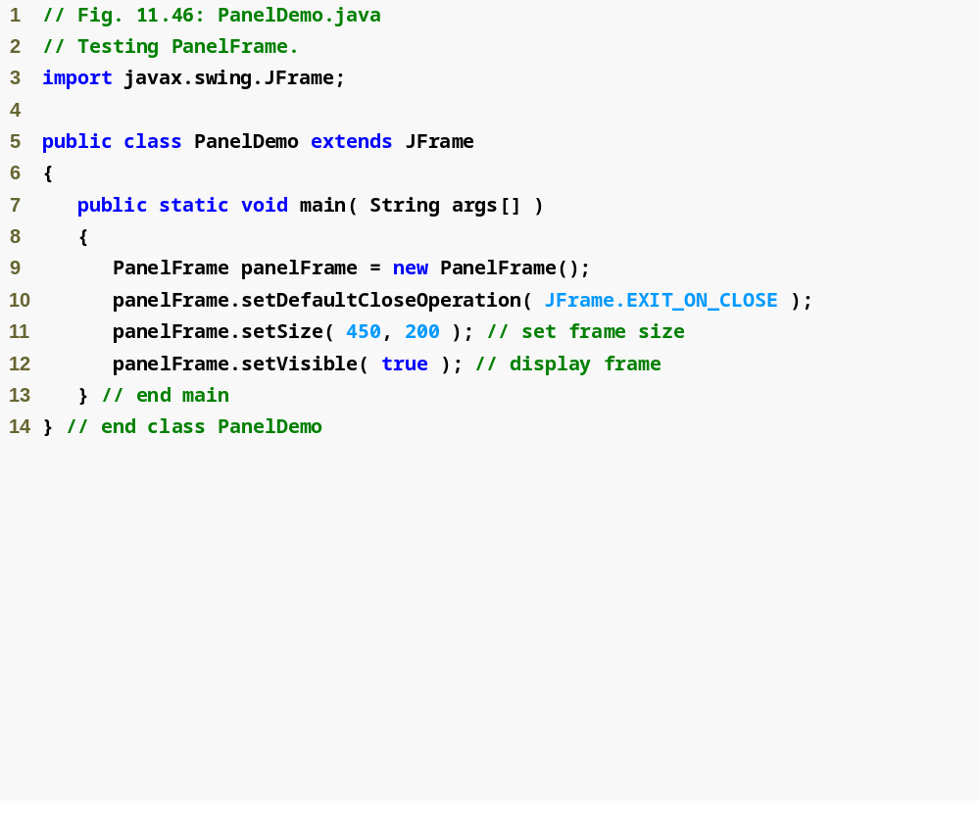
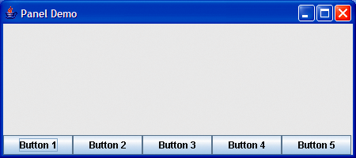
Outline
PanelDemo.java

Slide 27
Several AWT and Swing classes provide layout managers for general use:
BorderLayout.
BoxLayout.
CardLayout.
FlowLayout.
GridBagLayout.
GridLayout.
GroupLayout.
SpringLayout.

